Slide 1
Visual and
Web Design
Lab Project Proposal
Course Code: CSE310, Section: B1
Instructor: Durjoy Mistry

Slide 2

Team members
Nafis Fuad Barshan
Tanvir Rahan Rifat
Taohid Khan
Registration: 21201166
Registration: 22101065
Registration: 22101070

Slide 3

Online Learning & Tutoring System

Slide 4
Introduction
The Digital Tutoring Platform is an online system designed to bridge the gap between students and tutors. It helps students find the right tutors based on their needs and allows tutors to offer personalized classes. With features like live classes, course materials, feedback. This platform simplifies online education and makes it more accessible to everyone.

Slide 5
Problem Statement
Key Problems:
Missing deadlines for exam preparations
Lack of proper concepts
Unprepared for tests coming nearby
Poor time management and lower-quality work
Affect of overall academic performance.
Chaotic study routines.
Unavailability of urgent tutor

Slide 6
Objectives
Student could ask for a personal tutor anytime
We would provide certificates to recognize achievements upon course completion
Making a user-friendly interphase
Solving unemployment problem for aspiring tutors
Minimizing the problem for procrastination or other reasons

Slide 7
Features
1. Creating an Online Platform
Students registration :
Details Required : Name, Mobile Number, Email Address
Instructors registration:
Details Required : Name, Number, Email, Subject
2. One-to-one communication
In-site one-to-one calling session
3. Payment
Fee depending on how much time the student wants assistance
4. Review Section

Slide 8
Unique Features
A student & teacher friendly platform
One-to-one in-site video conference
Teacher & Student separate feed
E-certificates upon course completion
Separate course section for teachers
Create courses
Strengthen up their in-site portfolios

Slide 9
Social Benefits
Reduce trouble for students with necessary academic needs
Temporary solution for unemployment problems
Great earning platform for instructors

Slide 10
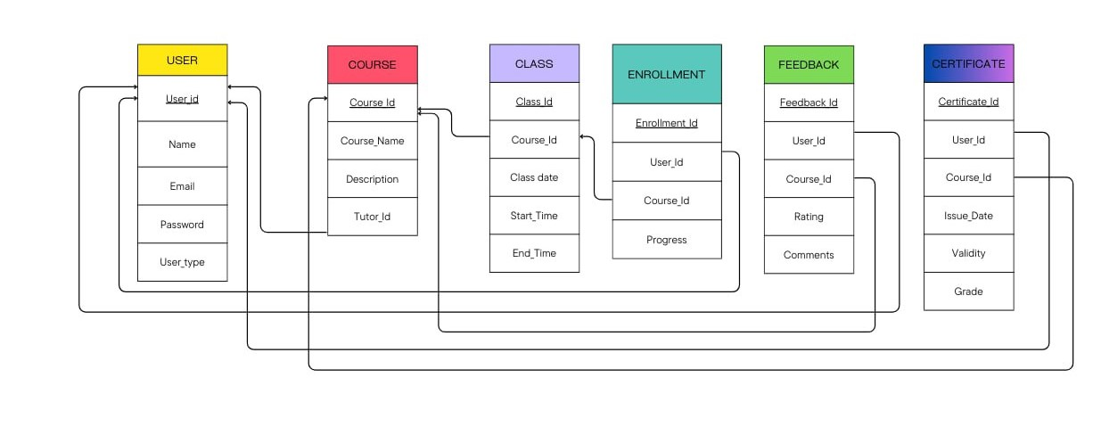
Class Diagram

Slide 11
Class Table
Class_Id: int
Course_Id: int
Class_Date: datetime
Start_Time: time
End_Time: time
Enrollment Table:
Enrollment_Id: int
User_Id: int
Course_Id: int
Progress: varchar(50)
Feedback Table:
Feedback_Id: int
User_Id: int
Course_Id: int
Rating: int
Comments: text
User Table:
User_Id: int
Name: varchar(255)
Email: varchar(255)
Password: varchar(255)
User_Type: varchar(50)
Course Table:
Course_Id: int
Course_Name: varchar(255)
Description: text
Tutor_Id: int
Certificate Table:
Certificate_Id: int
User_Id: int
Course_Id: int
Issue_Date: datetime
Validity: int
Grade: varchar(50)

Slide 12
Conclusion
The platform benefits both students and tutors by:
Allowing students to take classes from the comfort of their homes.
Providing tutors with a wider audience and flexible teaching options.

Slide 13
Q&A
Section
Any Questions?

